Slide 1
Decision rules
Practice

Slide 2
Decision or classification rules
"Read directly" from a decision tree
The PRISM algorithm (covering approach)
similar than "from decision tree" approach, but this time attribute-value is used to split the data instead of just the attribute

Slide 3
Outlook | Temp | Hum | Windy | Play
Sunny | Hot | High | False | No
Sunny | Hot | High | True | No
Overcast | Hot | High | False | Yes
Rainy | Mild | High | False | Yes
Rainy | Cool | Normal | False | Yes
Rainy | Cool | Normal | True | No
Overcast | Cool | Normal | True | Yes
Sunny | Mild | High | False | No
Sunny | Cool | Normal | False | Yes
Rainy | Mild | Normal | False | Yes
Sunny | Mild | Normal | True | Yes
Overcast | Mild | High | True | Yes
Overcast | Hot | Normal | False | Yes
Rainy | Mild | High | True | No
Seeking the rules for class “No”.
If ? then Play=no
Outlook=sunny: 3/5
Outlook=overcast: 0/4
Outlook=rainy: 2/5
Temp=cool: 1/4
Temp=mild: 2/6
Temp=hot: 2/4
Hum=high: 4/7
Hum=normal: 1/7
Windy=true: 3/6
Windy=false: 2/8
If Outlook=sunny and ? then Play=no
Temp=hot: 2/2
Temp=mild: 1/2
Temp=cool: 0/1
Hum=high: 3/3
Hum=normal: 2/2
Windy=false: 2/3
Windy=true: 1/2
If Outlook=sunny and Hum=high then Play=no
Outlook | Temp | Hum | Windy | Play
Sunny | Hot | High | False | No
Sunny | Hot | High | True | No
Sunny | Mild | High | False | No
Sunny | Cool | Normal | False | Yes
Sunny | Mild | Normal | True | Yes

Slide 4
Outlook | Temp | Hum | Windy | Play
Sunny | Hot | High | False | No
Sunny | Hot | High | True | No
Overcast | Hot | High | False | Yes
Rainy | Mild | High | False | Yes
Rainy | Cool | Normal | False | Yes
Rainy | Cool | Normal | True | No
Overcast | Cool | Normal | True | Yes
Sunny | Mild | High | False | No
Sunny | Cool | Normal | False | Yes
Rainy | Mild | Normal | False | Yes
Sunny | Mild | Normal | True | Yes
Overcast | Mild | High | True | Yes
Overcast | Hot | Normal | False | Yes
Rainy | Mild | High | True | No
If Outlook=sunny and Hum=high then Play=no
If ? then Play=no
Outlook=sunny: 0/2
Outlook=overcast: 0/4
Outlook=rainy: 2/5
Temp=cool: 1/4
Temp=mild: 1/5
Temp=hot: 0/2
Hum=high: 1/4
Hum=normal: 1/7
Windy=true: 2/5
Windy=false: 0/6
If Outlook=rainy and ? then Play=no
Temp=mild: 1/3
Temp=cool: 1/2
Hum=high: 1/2
Hum=normal: 1/3
Windy=false: 0/3
Windy=true: 2/2
If Outlook=rainy and Windy=true then Play=no
Outlook | Temp | Hum | Windy | Play
Rainy | Mild | High | False | Yes
Rainy | Cool | Normal | False | Yes
Rainy | Cool | Normal | True | No
Rainy | Mild | Normal | False | Yes
Rainy | Mild | High | True | No

Slide 5
RULES FOR CLASS “No”:
If Outlook=sunny
and Hum=high
then Play=no
If Outlook=rainy
and Windy=true
then Play=no

Slide 6
Outlook | Temp | Hum | Windy | Play
Sunny | Hot | High | False | No
Sunny | Hot | High | True | No
Overcast | Hot | High | False | Yes
Rainy | Mild | High | False | Yes
Rainy | Cool | Normal | False | Yes
Rainy | Cool | Normal | True | No
Overcast | Cool | Normal | True | Yes
Sunny | Mild | High | False | No
Sunny | Cool | Normal | False | Yes
Rainy | Mild | Normal | False | Yes
Sunny | Mild | Normal | True | Yes
Overcast | Mild | High | True | Yes
Overcast | Hot | Normal | False | Yes
Rainy | Mild | High | True | No
Seeking the rules for class “Yes”.
If ? then Play=yes
Outlook=sunny: 2/5
Outlook=overcast: 4/4
Outlook=rainy: 3/5
Temp=cool: 3/4
Temp=mild: 4/6
Temp=hot: 2/4
Hum=high: 3/7
Hum=normal: 6/7
Windy=true: 3/6
Windy=false: 6/8
If Outlook=overcast then Play=yes

Slide 7
Outlook | Temp | Hum | Windy | Play
Sunny | Hot | High | False | No
Sunny | Hot | High | True | No
Overcast | Hot | High | False | Yes
Rainy | Mild | High | False | Yes
Rainy | Cool | Normal | False | Yes
Rainy | Cool | Normal | True | No
Overcast | Cool | Normal | True | Yes
Sunny | Mild | High | False | No
Sunny | Cool | Normal | False | Yes
Rainy | Mild | Normal | False | Yes
Sunny | Mild | Normal | True | Yes
Overcast | Mild | High | True | Yes
Overcast | Hot | Normal | False | Yes
Rainy | Mild | High | True | No
If Outlook=overcast then Play=yes
Seeking rules for remaining examples.
If ? then Play=yes
Outlook=sunny: 2/5
Outlook=rainy: 3/5
Temp=hot: 0/2
Temp=mild: 3/5
Temp=cool: 2/3
Hum=high: 1/5
Hum=normal: 4/5
Windy=true: 1/4
Windy=false: 4/6
If Hum=Normal and ? then Play=yes
Outlook=rainy: 2/3
Outlook=sunny: 2/2
Temp=cool: 2/3
Temp=mild: 2/2
Windy=false: 3/3
Windy=true: 1/2
If Hum=Normal and Windy=false then Play=yes
Outlook | Temp | Hum | Windy | Play
Rainy | Cool | Normal | False | Yes
Rainy | Cool | Normal | True | No
Sunny | Cool | Normal | False | Yes
Rainy | Mild | Normal | False | Yes
Sunny | Mild | Normal | True | Yes

Slide 8
Outlook | Temp | Hum | Windy | Play
Sunny | Hot | High | False | No
Sunny | Hot | High | True | No
Overcast | Hot | High | False | Yes
Rainy | Mild | High | False | Yes
Rainy | Cool | Normal | False | Yes
Rainy | Cool | Normal | True | No
Overcast | Cool | Normal | True | Yes
Sunny | Mild | High | False | No
Sunny | Cool | Normal | False | Yes
Rainy | Mild | Normal | False | Yes
Sunny | Mild | Normal | True | Yes
Overcast | Mild | High | True | Yes
Overcast | Hot | Normal | False | Yes
Rainy | Mild | High | True | No
If Outlook=overcast then Play=yes
If Hum=Normal and Windy=false then Play=yes
If ? then Play=yes
Outlook=rainy: 1/3
Outlook=sunny: 1/4
Temp=hot: 0/2
Temp=mild: 2/4
Temp=cool: 0/1
Hum=high: 1/5
Hum=normal: 1/2
Windy=false 1/3
Windy=true: 1/4
If Temp=mild and ? then Play=yes
Outlook=rainy: 1/2
Outlook=sunny: 1/2
Hum=high: 1/3
Hum=normal: 1/1
Windy=false: 1/2
Windy=true: 1/2
If Temp=mild and Hum=normal then Play=yes
Outlook | Temp | Hum | Windy | Play
Rainy | Mild | High | False | Yes
Sunny | Mild | High | False | No
Sunny | Mild | Normal | True | Yes
Rainy | Mild | High | True | No

Slide 9
Outlook | Temp | Hum | Windy | Play
Sunny | Hot | High | False | No
Sunny | Hot | High | True | No
Overcast | Hot | High | False | Yes
Rainy | Mild | High | False | Yes
Rainy | Cool | Normal | False | Yes
Rainy | Cool | Normal | True | No
Overcast | Cool | Normal | True | Yes
Sunny | Mild | High | False | No
Sunny | Cool | Normal | False | Yes
Rainy | Mild | Normal | False | Yes
Sunny | Mild | Normal | True | Yes
Overcast | Mild | High | True | Yes
Overcast | Hot | Normal | False | Yes
Rainy | Mild | High | True | No
If Outlook=overcast then Play=yes
If Hum=Normal and Windy=false then Play=yes
If Temp=mild and Hum=normal then Play=yes
If ? then Play=yes
Outlook=rainy: 1/3
Outlook=sunny: 0/3
Temp=hot: 0/2
Temp=mild: 1/3
Temp=cool: 0/1
Hum=high: 1/5
Hum=normal: 0/2
Windy=false 1/3
Windy=true: 0/3
If Outlook=rainy and ? then Play=yes
Temp=mild: 1/2
Temp=cool: 0/1
Hum=high: 1/2
Hum=normal: 0/1
Windy=false: 1/1
Windy=true: 0/2
If Outlook=rainy and Windy=false then Play=yes
Outlook | Temp | Hum | Windy | Play
Rainy | Mild | High | False | Yes
Rainy | Cool | Normal | True | No
Rainy | Mild | High | True | No

Slide 10
RULES FOR CLASS “Yes”:
If Outlook=overcast
then Play=yes
If Hum=normal and Windy=false
then Play=yes
If Temp=mild
and Hum=normal
then Play = yes
If Outlook=rainy
and Windy=false
then Play = yes
The order is not important, because all rules cover the same class !!!

Slide 11
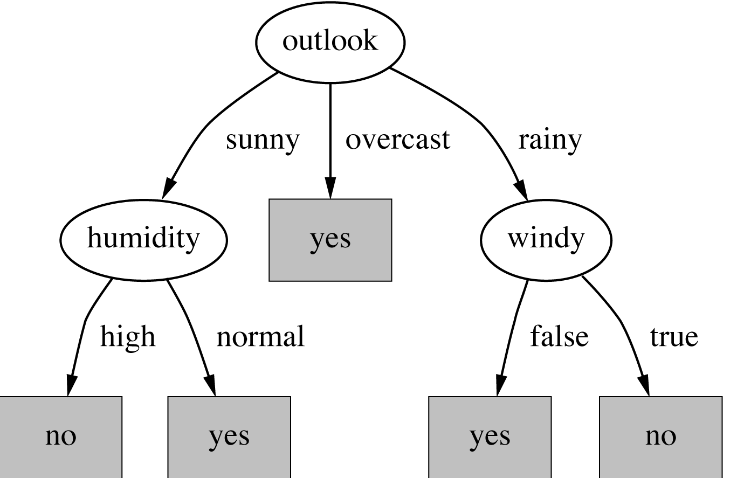
A comparison with the decision tree
RULES FOR CLASS “No”:
If Outlook=sunny
and Hum=high
then Play=no
If Outlook=rainy
and Windy=true
then Play=no
RULES FOR CLASS “Yes”:
If Outlook=overcast
then Play=yes
If Hum=normal and Windy=false
then Play=yes
If Temp=mild
and Hum=normal
then Play=yes
If Outlook=rainy
and Windy=false
then Play=yes

Slide 12
Let′s try another example …
… on the "contact lenses" data (contact-lenses.arff)

