Slide 1
3D rendering
3D Game Development
Jernej Vičič

Slide 2
Overview (book: 10.1 – 10.5)
Introduction
triangle meshes and tessellation;
coordinate spaces and transformations of representations;
lighting, color and texture;
virtual cameras.
Unity and render pipelines
Convert from built in RP to HDRP
Notes:
meshes and tesselation
coordinate spaces

Slide 3
Introduction
the main thing,
basic concepts: theory and mathematics for all real-time 3D engines,
SW and HW pipelines,
basic optimization techniques.

Slide 4
Triangle rasterization
the virtual scene is described with 3D surfaces (in some mathematical form),
the virtual camera is set up facing the scene in the desired direction,
typically, the camera is modeled as an idealized focal point with a picture that is somewhat distant,
different light sources are defined, which are the source of light rays, which are reflected from objects on the scene.

Slide 5
Triangle rasterization
visual characteristics of the surfaces (materials, colors),
determine how the light is reflected from the surfaces,
for each pixel of the rendering rectangle,
engine calculates the color and the intensity of the light beam that flows into the focal point of the virtual camera through this pixel,
this is called a rendering/shading equation

Slide 6
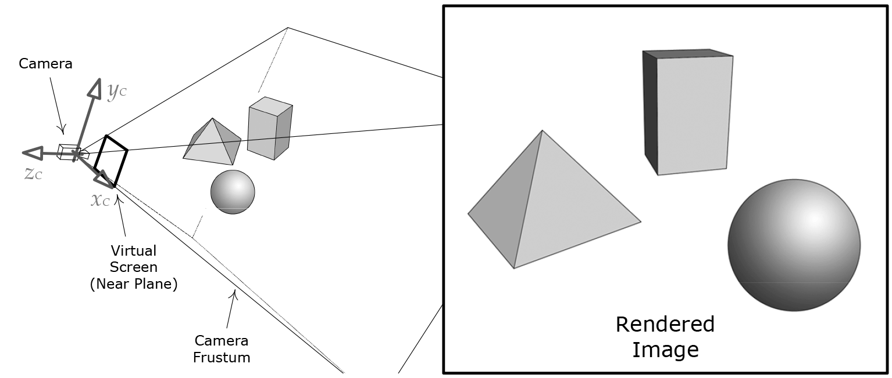
Triangle rasterization

Slide 7
Scene description
all these steps are executed at 30/50/60 fps,
the time is also shared with all subsystems.

Slide 8
Triangle rasterization
the scene consists of objects,
solid (brick),
amorphous (smoke),
occupy space in 3D,
opaque (only the surface is important),
transparent, translucent (the interior should also be modeled - reflecting and scattering light on the interior of the building),
Only the newest engines implement this.

Slide 9
Presentation of the scene in 3D modelling programs
parametric surface equation,
too cumbersome, each object would have its own type of equation,
the film industry uses:
rectangular patches:
each made of 2D spline with a smaller number of control points,
various splines are used:
Bezier surfaces, ...

Slide 10
Presentation of the scene – triangle mesh
triangle mesh,
triangle is the simplest polygon,
triangle is always planar (three points define a plane, each fourth point can be off the plane),
most of the transformations preserve triangles (especially affine and most projections - can degenerate into a line),
most graphics cards use rasterization of triangles.

Slide 11
Presentation of the scene – triangle mesh
tesselation = mosaic arrangement of geometric shapes on the plane,
problem:
tessellation is defined by the artist when he/she draws a scene,
objects can be triangular when observed too closely,
solution:
subdivison surfaces - the surfaces are tiled according to the distance of the camera.

Slide 12
Presentation of the scene – triangle mesh
the tessellation problem is solved by LOD,
LOD0, LOD1, LODx
are replaced when the camera moves away from the subject,
dynamic tessellation - for meshes that are repeating - water, landscape,
progressive meshes - dynamic tessellation and LOD, uses one LOD0 and when the camera moves away dynamically bind triangles - combines nodes.

Slide 13
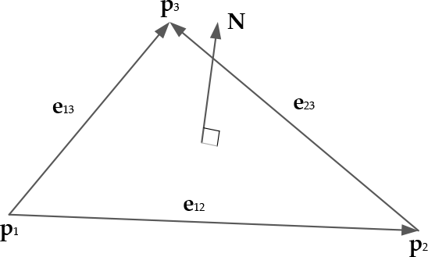

Presentation of the scene – triangle mesh
production of a triangle mesh,
winding order:
triangle is defined ny position vectors (3 points):
e₁₂=p₂-p₁
e₁₃=p₃-p₁
e₂₃=p₃-p₂
normalised vector product of either pair, the order is defined at modelling,
wrong order reflects in rendering the wrong side of a triangle.

Slide 14
Presentation of the scene – triangle mesh
winding order:
back-face culling - graphics card only renders the visible side of the triangle.

Slide 15
Presentation of the scene – triangle mesh
lists of triangles:
each triangle is defined by three points,
triangles are listed in a linked list.
indexed lists of triangles:
a list of all nodes, stored in a vertex buffer (DirectX) or a vertex array (OpenGL),
the element in the vertex index represents a triangle.

Slide 16
Presentation of the scene – triangle mesh
a triangle strip and a vertex fan are also used,
saving memory, improving cache coherency,
cache access can be optimized offline.
World space:
many individual meshes can be on one scene,
a street with the same lights, a swarm of bees,
mesh instance,
reference to common data,
transformation matrix (model to world matrix).

Slide 17
Presentation of the scene – visual surface properties - light
electromagnetic waves and particle beams,
it is defined by the intensity I and the wavelength λ,
visible light: 380nm - 740nm.

Slide 18
Presentation of the scene– light
the interaction between light and objects,
absorbs,
reflects,
diffusely (in all directions),
specular - almost completely back - mirror,
anisotropic - the mode of reflection depends on the angle,
transmits through the object, usually refracts,
curves in narrow passages (rarely implemented).

Slide 19
Presentation of the scene– colour
Color spaces and color models,
color model: 3D coordinate system that measures colors,
color space: a standard that determines how the numerical values of the selected model are mapped to colors as seen by human,
the most common:
RGB,log-LUV for High Dynamic Range (HDR),
the color format defines how many bits will be used for each channel - usually 3 channels.

Slide 20
Presentation of the scene– colour
opacity,
alpha channel defines how opaque is the color/material,
fully opaque (no light goes through).

Slide 21
Presentation of the scene– vertex attributes
position vector: p_{i} = [p_{ix} p_{iy} p_{iz}], usualy in local system,
vertex normal: n_{i} = [n_{ix} n_{iy} n_{iz}],
normalised vector, an average of all normaln vectors,
vertex tangent t_{i} = [t_{ix} t_{iy} t_{iz}] iandn bitangent b_{i} = [b_{ix} b_{iy} b_{iz}],
perpendicular a normal point vector, - per pixel lighting, tangent space.

Slide 22
Presentation of the scene– vertex attributes
diffuse color: d_{i} =[d_{iR} d_{iG} d_{iB} d_{iA}],
RGB + Alpha,
specular color: s_{i} =[s_{iR} s_{iG} s_{iB} s_{iA}],
how much light is reflected if the ray is perpendicular to the surface,
texture coordinates: u_{i} =[u_{ij} u_{ij}],
enable texture mapping to the mesh,
point has textures (in j).

Slide 23
Presentation of the scene– vertex attributes
skinning effects k_{ij} =[k_{ij} k_{ij}],
in skeletal animation, some mash points are connected to joints
multiple connections,
weights.

Slide 24
Presentation of the scene– vertex attributes
format:
struct Vertex1P
{
Vector3 m_p; // position
};
// A typical vertex format with position, vertex normal
// and one set of texture coordinates.
struct Vertex1P1N1UV
{
Vector3 m_p; // position
Vector3 m_n; // vertex normal
F32 m_uv[2]; // (u, v) texture coordinate
};

Slide 25
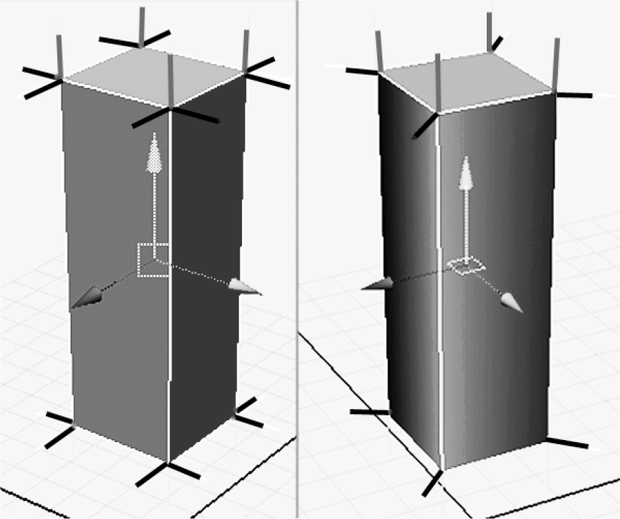
Presentation of the scene– vertex attributes
atribute interpolation,
attributes in the nodes of the mash are a rough approximation of the visual properties of the surface,
we are interested in points inside the triangle,
we need per-pixel values (of attributes).

Slide 26
Presentation of the scene– textures
texture maps,
covering large triangles,
they may have a sample,
color can solve the accuracy/inaccuracy of the objects,
individual elements - texel (analogy with pixel),
the size usually is 2^{n}.

Slide 27
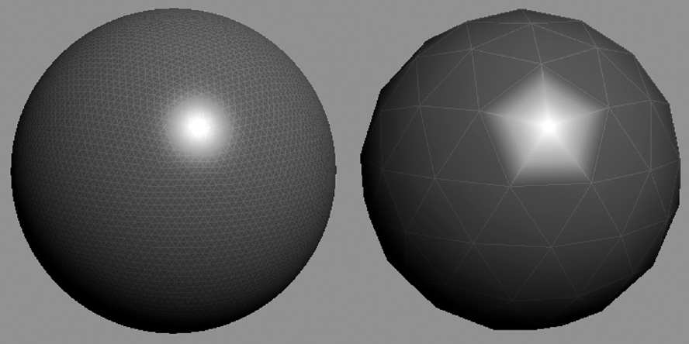
Presentation of the scene– textures
texture maps:

Slide 28
Presentation of the scene– textures
types of textures,
diffuse map, describes every texel on the surface,
normal maps - normal vectors on each texel,
gloss maps - encode how the luminous surface should be on each texel,
environment maps – use an image of an adjacent environment for rendering (reflections).

Slide 29
Presentation of the scene – textures
texture coordinates,
texture space - 2D coordinate system,
normalized coordinates: (0,0) - (1,1) local coordinate system,
to map a triangle to a texture: just get these coordinates.

Slide 30
Presentation of the scene– textures
methods of addressing textures,
wrap, texture is repeated to the border,
mirror, mirrored texture to the border,
clamp, the color of the external texels continues to the end of the area,
border color:
selected color is all around the texture.

Slide 31
Presentation of the scene – textures
texture formats:
on a disc in any format,
compressed textures,
4x4 pixel blocks,
less space is occupied,
access to cache is also faster for rendering.

Slide 32
Presentation of the scene – textures
texel density and mipmapping:
whole screen is made out of 2 triangles,
texture has the same resolution as screen,
1 texel – maps– 1 pixel,
texel density = 1.

Slide 33
Presentation of the scene – textures
texel density < 1,
texet is bigger than pixel
borders are visible,
texel density > 1,
many texels define colour for one pixel:
additional memory usage,
moire effect,
a pixel with a small change of view changes the color.

Slide 34
Presentation of the scene – textures
solution:
we want texel density around 1 all the time,
mipmapping (mipmap, mip level):
each texture: a list of bitmaps of lower resolutions (each half size).
Notes:
In computer graphics, mipmaps (also MIP maps) or pyramids ^{[1][2][3]} are pre-calculated, optimizedsequences of images, each of which is a progressively lower resolution representation of the same image.
The letters "MIP" in the name are an acronym of the Latin phrase multum in parvo, meaning "much in little".

Slide 35
Presentation of the scene – materials
material:
a complete description of the visual characteristics of the mash,
vertex attributes are not part of the description of the material,
but they are added so that it is all in one place,
1 model usually has several materials - eyes, hair, skin.

Slide 36
Presentation of the scene – lighting
example: Naughty Dog’s The Last of Us
3 images of the same 3D model,

Slide 37
rendered no textures

Slide 38
rendered only diffuse textures

Slide 39
rendered full lighting

Slide 40
Presentation of the scene – lighting
shading,
lighting + all visual effects,
procedural deformation of nodes
for simulation of movement of water,
moving hair in the wind,
surface tessellation,
other calculations needed to render the scene.

Slide 41
Presentation of the scene – lighting
local and global lighting models,
light transport models,
light-surface,
light-volume.
simple:
only direct light that is reflected from the object to the virtual camera,
local lighting models,
used even now.

Slide 42
Presentation of the scene – lighting
global lighting models,
perfect photorealism,
also take into account indirect light,
fully described by the mathematical formulation:
rendering equation or shading equation,
1986 by J. T. Kajiya SIGGRAPH,
each model solves this formulation in its own way.

Slide 43
Presentation of the scene – lighting - local models
The Phong Lighting Model,
most common:

Slide 44
Presentation of the scene – lighting – local models
The Phong Lighting Model,
ambient term - total lighting of the scene,
approximation of indirect illumination,
diffuse term - light that is uniformly reflected in all directions from each object (good for matted surfaces),
specular term - bright spots that are sometimes on a glossy surface.

Slide 45
Presentation of the scene – lighting – local models
The Phong Lighting Model,
applied to each color component separately (RGB),
inputs:
viewing direction vector V = [V_{x} V_{y} V_{z}],
ambient light intensity A = [A_{R} A_{G} A_{B}],
normal surface vector N = [N_{x} N_{y} N_{z}],

Slide 46
Presentation of the scene – lighting – local models
The Phong Lighting Model,
surface reflectance:
ambient reflectivity k_{A} =k_{AR} k_{AG} k_{AB}
diffuse reflectivity k_{D} = k_{DR} k_{DG} k_{DB}
specular reflectivity k_{S} =k_{SR} k_{SG} k_{SB}
specular “glossiness” exponent ;
for each light source i:
colour and intensity C_{i} = C_{iR} C_{iG} C_{iB}
direction vector L_{i}.

Slide 47
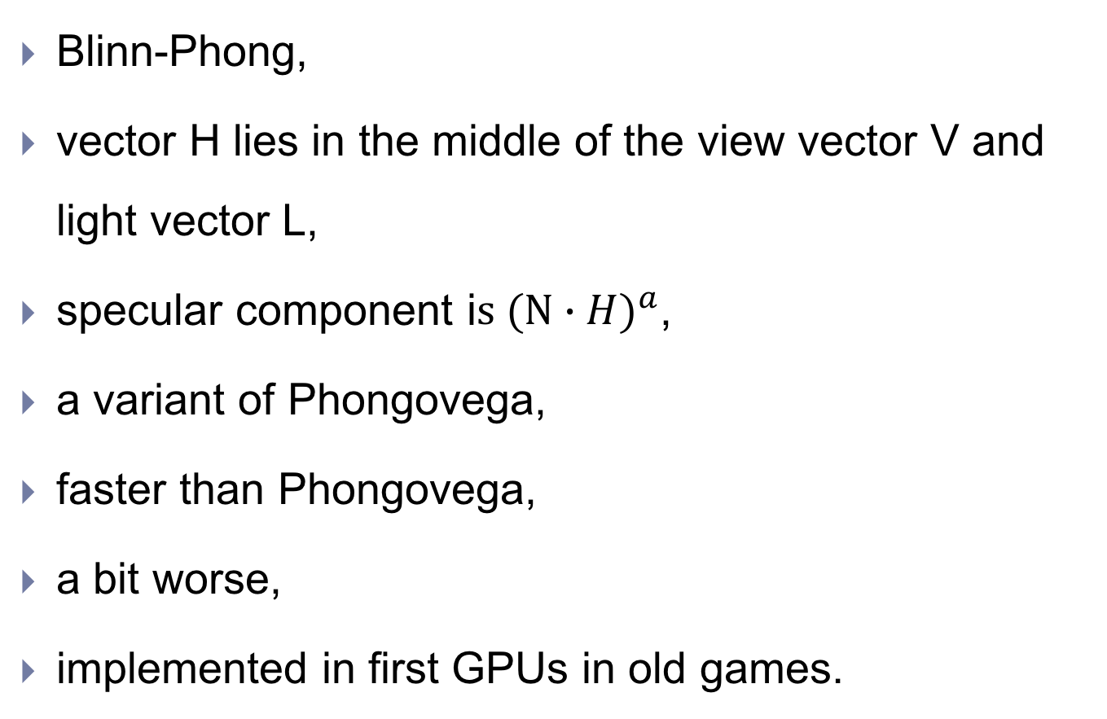
Presentation of the scene – lighting – local models

Slide 48
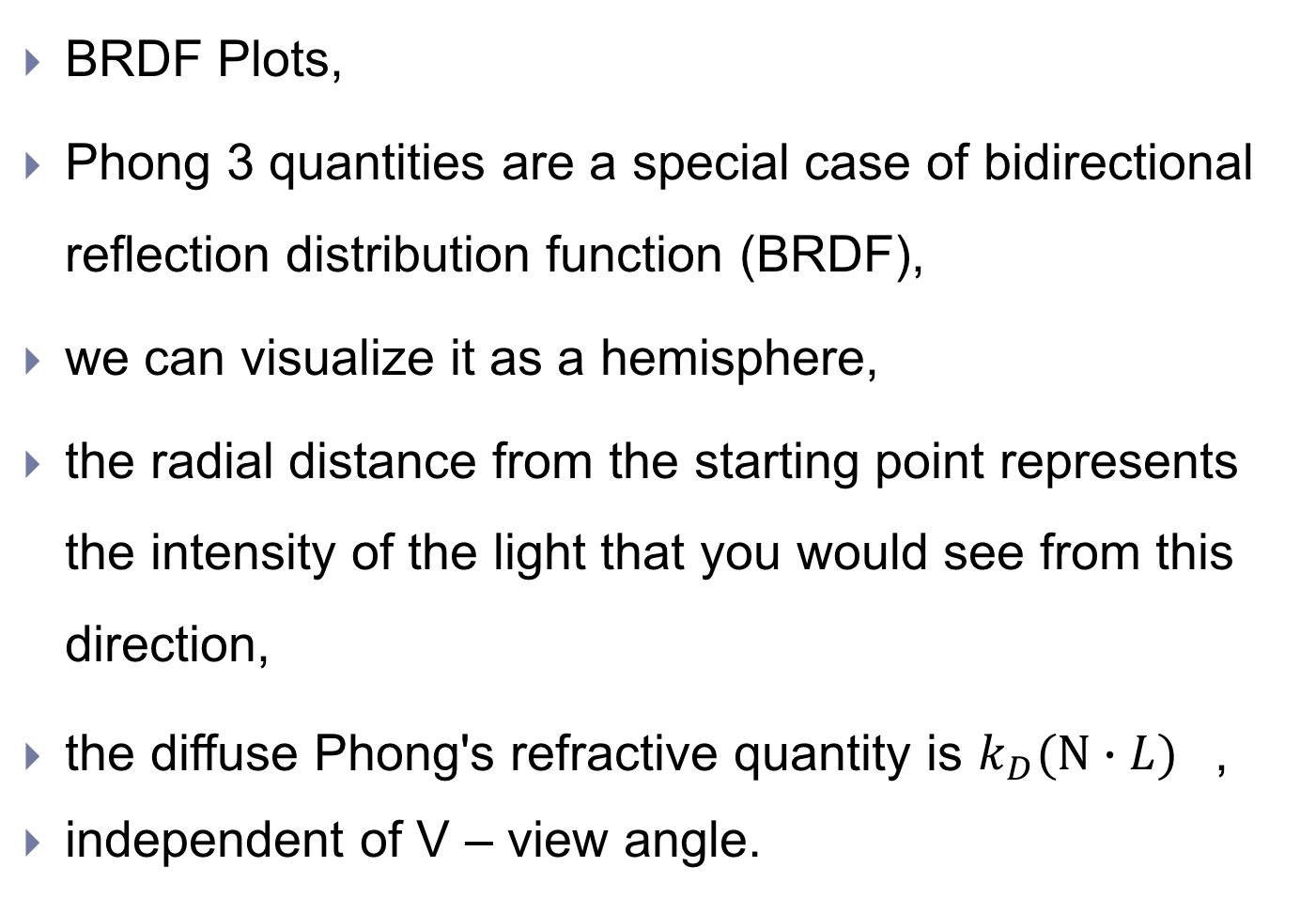
Presentation of the scene – lighting – local models

Slide 49
Presentation of the scene – light source modelling
static lighting,
the simplest calculation,
we calculate Phong's reflection in all the nodes of the mash in advance and get it as diffuse vertex color attributes,
we can calculate the illumination for each pixel and get it as a new texture - light map,
at runtime light map, the texture is projected onto objects.

Slide 50
Presentation of the scene – light source modelling
ambient lighting,
corresponds to the ambient amount of Phong's illumination,
depends on the viewing angle,
modeled with the amount of color A in the Phong equation,
directed light,
infinite remote source (sun),
rays are parallel,
modeled with color C and direction L.

Slide 51
Presentation of the scene – light source modelling
light from a point (in all directions),
precise position in the scene,
the intensity falls with the square of the distance from the starting point,
modeled with position P, color C and max radius r,
the renderer takes into account only those sources that are distant less than r.

Slide 52
Presentation of the scene – light source modelling
reflector,
acts as a light from a point, rays are limited to a cone,
usually two cones,
the inner one has full intensity,
the outer one minimal,
model: position P, colour C, direction vector L – center, max radius r, fi_{min}, fi_{max},

Slide 53
Presentation of the scene – light source modelling
area lights,
stressed shadows and half-shades,
we usually model with tricks,
emissive lights,
some surfaces are also sources of light,
emissive texture map.

Slide 54
Presentation of the scene – virtual camera
simplified camera or eye,
part is an ideal focal point,
perpendicular virtual sensory surface (receptors),
imaging rectangle.

Slide 55
Presentation of the scene – virtual camera
view space, camera space,
the virtual camera's focal point is the center of this 3D space,
model-view matrix.

Slide 56
Presentation of the scene – virtual camera
projections,
3D scene is presented on 2D plane - screen,
projection,
usually perspective projection,
simulates the "real" camera,
objects that are more distant are smaller,
orthographic projection,
maintains the size,
It is used for map- editing mode.

Slide 57
Presentation of the scene – virtual camera
view volume in frustrum – cut pyramid,
6 surfaces,
nearby - virtual receptors,
the farthest surface- the outermost part, which is still rendered,
perspective projection - truncated pyramid,
orthagonal projection - Cuboid.

Slide 58
Presentation of the scene – virtual camera
perspective projection OpenGL,
projection matrix M_{V->H},
near surface z=-n,
OpenGL matrix:
furthest surface z=-f,
x=l, x=r, y=t,y=b (left, right, top, bottom),
DirectX matrix: z akex is on interval [0, 1], OpenGL: [-1,1].

Slide 59
Presentation of the scene – virtual camera - projections
perspective projection DirectX,
DirectX matrix: z axel is on interval [0, 1], OpenGL: [-1,1].

Slide 60
Presentation of the scene – virtual camera - projections
perspective projection example,
p_{H}=p_{V}M_{V->H}=

Slide 61
Presentation of the scene – virtual camera
screen space – view,
2D coordinate system, axles in pixels,
screen mapping:
when rendering, we ignore the component from the 3D world,
x, y coordinates are shifted and scaled according to the screen geometry: 4:3, 19:9, 16:10.

Slide 62
Presentation of the scene – virtual camera – frame buffer
the final rendered image is stored as a bitmap in the frame buffer structure
format usually: RGBA8888,
usually we use at least two frame buffers - double buffering,
one uses HW to display an image,
the other prepares the engine for the next frame, so it ensures that HW always reads the whole picture.

Slide 63
Presentation of the scene – rendering pipeline
rendering pipeline,
cevovod = ordered stream of computing units,
output₁=input₂,
throughput – how much data /s,
latency – how much time it takes for a single element,
both depending on the slowest link.

Slide 64
Presentation of the scene – rendering pipeline
enables simple parallelization (if we can divide the data into independent parts),
parallelization also in individual stages

Slide 65
Presentation of the scene rendering pipeline
stages:
tools - tools stage (offline), definition of geometry and materials,
processing of geometry and materials into suitable formats - asset conditioning stage (offline),
asset conditioning pipeline (ACP) in engine-ready format,
searching for potentially visible mashes - the application stage (CPU), eventually sending to the rendering,
geometry processing - geometry processing stage (GPU),
the nodes are transformed and lighted, correctly projected, the triangles are shaded and glued to the frustrum.

Slide 66
Presentation of the scene – rendering pipeline
rasterization stage (GPU),
triangles are divided into fragments, they are shaded, tested, and gathered at the end in a frame buffer.

Slide 67
Presentation of the scene – rendering pipeline
implementation of pipeline stages,
1,2 offline – programs on Windows or Linux computer,
3 – CPU on console or PC (PS3 – SPU parallel processing unit),
4,5 usually on GPU, helped by CPU.

Slide 68
Presentation of the scene – rendering pipeline
tools,
3D modelling:
DCC – Digital Content Creation (application),
Maya, 3D Studio Max, Lightwave, Softimage,
outputs are 3D models in nurbs, quads, triangles, …
materials:
artists define materials for individual parts of 3D models:
shader definitions for each material, texture selection, shade parameters,
the properties of the nodes are defined by drawing in the DCC,
materials can be added to individual mashes - data duplication - usually library of materials – index.

Slide 69
Presentation of the scene – rendering pipeline
tools,
3D modelling:
Unreal – graphics shading language:

Slide 70
Presentation of the scene – rendering pipeline
Asset Conditioning Pipeline – ACP:
converted to "format" of the game,
extracts the geometry and materials from the DCC format,
connects with the skeleton,
correctly transferring skins,
static lighting,
production of a high-level tree of the game - BSP tree.

Slide 71
Presentation of the scene – GPU
GPU can be presented as a pipeline (modern GPU).

Slide 72
Presentation of the scene – GPU
Vertex Shader,
transformation and shading/lighting of nodes,
the input is a single node (more in parallel),
transformation from model space to world space,
projection,
skinning for nodes,
animations on textures - movement of leaves,
output:
a node with a normal vector and a position in a homogeneous clip space,
the node is shaded.

Slide 73
Presentation of the scene – GPU
Geometry Shader,
optional,
works in a homogeneous clip space on whole primitives - triangles, lines, points,
can generate new primitives,
usage:
rendering 6 surfaces of space map,
production of primitives from individual points,
dynamic tessellation, division of lines into individual sections for lighting, simulation of clothing (upper layers).

Slide 74
Presentation of the scene – GPU
Stream Output,
saves the data back into memory,
returns to the previous stages of the pipeline,
GPU performs some CPU work or certain effects:
moving of hair in the wind:
collection of cubic spline curves,
simulation of the physics is done by GPU controlling points of the curves.

Slide 75
Presentation of the scene – GPU
Clipping,
cuts off those parts of the triangles that are outside the field of vision,
frustrum,
new points where the triangles intersect the plane of the pyramid become new vertices of triangles,
the stage is fixed, additional surfaces that can cut the space can be determined.

Slide 76
Presentation of the scene – GPU
Screen Mapping,
scales and moves nodes from a homogeneous clip space into the screen space,
completely fixed rate.

Slide 77
Presentation of the scene – GPU
Triangle Set-up,
initializes HW to convert triangles into fragments,
completely fixed rate.

Slide 78
Presentation of the scene – GPU
Triangle Traversal,
each triangle is divided into fragments (rasterized),
usually at the pixel level, but it's not necessary,
it can be more in both directions,
interpolates node attributes for per-pixel shading,
completely fixed rate.

Slide 79
Presentation of the scene – GPU
Early z –Test,
tests the depth,
if a pixel is in front of the pixel it processes, it is deleted,
completely fixed rate.

Slide 80
Presentation of the scene – GPU
Pixel Shader,
fully programmable stage,
shades and illuminates each fragment of the previous phases,
it can also delete items if it calculates that they are completely transparent,
input:
collection of per-fragment attributes,
output:
one color vector describing ONE colour of the fragment.

Slide 81
Presentation of the scene – GPU
Merging / Raster Operations Stage,
completely fixed stage,
merging stage - blending stage,
NVIDIA: Raster OPerations - ROP,
fragment tests (including depth test, after the shading can be invisible fragments again),
alpha test - permeability/transparency,
stencil test:
stencil buffer,
additional to the depth test,
provides an additional option for displaying a pixel,
even if the depth test is not successful,
the value of the stencils can affect the surroundings,
Let's look at the example: https://open.gl/depthstencils

Slide 82
Presentation of the scene – shading
Programmable shaders,
first in DirectX 8,
GLSL – OpenGL Shading Language,
HLSL – DirectX High Level Shading Language,
input: one element,
output: 0 ore more elements,

Slide 83
Presentation of the scene – shading
Programmable shaders,
vertex shader:
input: vertex in model space,
output: vertex v homogenous clip space with lighting,
geometry shader:
one n-vertex primitive,
point (n=1), line segment (n=2), triangle(n=3),
returns many primitives – a point returns two triangles,
pixel shader:
input : fragment,
output : colour (homogenous for whole fragment) – written to frame buffer.

Slide 84
Presentation of the scene – memory access
memory access,
no direct access to memory - optimized,
shader can access memory via:
shader registers,
GPU registers,
128 bit SIMD format,
4x32bit float or int number,
in the register we get (float4):
4 element vector coordinates orcolor RGBA,
each component 32 bit float
scalar - all 4 values are the same,
matrices are put into float4x4 - HW ensures the transfer to 4 registers.

Slide 85
Presentation of the scene – memory access
memory access,
no direct access to memory - optimized,
shader can access memory also through:
textures:
read-only access to texture maps,
addressing is in texture coordinates,
writing in texture: render to texture - rendering in the off-screen buffer and declaring it as texture.

Slide 86
Presentation of the scene – HLSL
High-Level Shader Language,
syntax similar to C,
declare functions,
defines struct,
performs arithmetic operations,
the variables are mapped directly into the registers,
semantics, a colon follows the variable and the attribute of the fragment, which is mapped to the variable:
struct VtxOut
{
float4 pos : POSITION; // map to position attribute
float4 color : COLOR; // map to color attribute
};

Slide 87
Presentation of the scene – HLSL
High-Level Shader Language,
he variables are mapped directly into the registers,
if the variable is passed as a function parameter it is mapped to the input register,
the result of a function is mapped to the output register
VtxOut vshaderMain(VtxIn in) // maps to input registers
{
VtxOut out;
// ...
return out; // maps to output registers
}

Slide 88
Presentation of the scene – HLSL
High-Level Shader Language,
variables are directly mapped onto registers,
uniform declaration, this is mapped to constant registers:
VtxOut vshaderMain(
VtxIn in,
uniform float4x4 modelViewMatrix)
{
VtxOut out;
// ...
return out;
}

Slide 89
Presentation of the scene – HLSL
High-Level Shader Language,
arithmetic operations:
VtxOut vshaderMain(VtxIn in, uniform float4x4 modelViewMatrix)
{
VtxOut out;
out.pos = mul(modelViewMatrix, in.pos);
out.color = float4(0, 1, 0, 1); // RGBA green
return out;
}

Slide 90
Presentation of the scene – antialiasing
aliasing
it arises with a discrete description of continuous surfaces (tessellation of 3D plots),
antialiasing
an operation that eliminates this effect.

Slide 91
Presentation of the scene – antialiasing

Slide 92
Presentation of the scene – application stage
determining visibility,
only objects that are potentially visible should go to the GPU,
sending geometry to GPU,,
DrawIndexedPrimitive() (DirectX),
glDrawArrays() (OpenGL),
control of shading parameters,
constant parameters are sent to constant registers for each primitive.

Slide 93
Presentation of the scene – application stage
determining visibility,
Frustum Culling,
Occlusion and Potentially Visible Sets,
Portals,
Occlusion Volumes (Antiportals).

Slide 94
Presentation of the scene – application stage

Slide 95
Presentation of the scene – application stage

Slide 96
Presentation of the scene – Scene graphs
games have big worlds,
we need a data structure for the world description.

Slide 97
Presentation of the scene – Scene graphs
quadtree, octotree
space is s divided into quadrants (recursively),
vertex and 4 children.

Slide 98
Presentation of the scene – Scene graphs
BSP tree - Binary space Partitioning tree,
each step divides the space in 2 halves (recursively)

Slide 99
Presentation of the scene – vizualni efekti
special rendering systems,
particle effects:
smoke, sparks,
fire, decals:
holes from fire arms, cracks, scratches, small details,
hair and fur,
rain, snow, water, ...
full screen effects:
vignette (reduced brightness, edge saturation), motion blur, ...
menu, HUD – Heads-Up Display.

Slide 100
Presentation of the scene – vizualni efekti
particle effects,
smoke, sparks, fire,
many particles of simple geometries,
simple quads consisting of 2 triangles
object normals are facing the camera,
the material is partially semitransparent or translucent
animations are very different, they are changing rapidly
position, orientation, texture coordinates
changes - animation curves or procedures,
particles are born and dying (spawned and killed continually).

Slide 101
Presentation of the scene – visual effects

Slide 102
Presentation of the scene – visual effects
decals,
a small piece of geometry, placed on regular geometry,
holes of firearms, cracks, scratches, small details,
modeled as a rectangle on a surface projected by the beam into the scene,
we get a rectangular prism,
triangles that are cut with the base of the prism are already cut by the prism surfaces,
the texture of a decal is glued to the new triangles (produced by cutting the basic ones).

Slide 103
Presentation of the scene visual effects

Slide 104
Presentation of the scene – visual effects
environmental effects
sky:
we do not model because it is too far,
fill the frame buffer with an appropriate texture,
then fill the FB with a 3D rendered image,
we only look at scaling and ROTATION when moving the camera,
terrain:
it can be modeled, but often it is an overkill, especially for external scenes,
Height field terrain:
black and white texture maps.

Slide 105
Presentation of the scene – visual effects
environmental effects
water:
oceans, pools, rivers, waterfalls, fountains, jets, lakes, wetlands, wet materials,
some require shifts - river,
large objects require dynamic tessellation,
they can affect the gameplay - holding, swimming, and pushing a water jet.

Slide 106
Presentation of the scene – signs
overlays,
2D or 3D,
rendered directly to the view space,
following the camera,
normalized screen coordinates,
the game usually provides several resolutions,
the inscriptions are properly normalized,
coordinates:
0,0 – 1,0 for y axel,
x axel for 4:3 geometry: 0,0 – 1,333,
x axel for 16:9 geometry : 0,0 – 1,777,

Slide 107
Scene representation – signs
text and fonts,
font is a special 2D overlay,
usually a texture map with necessary glyphs,
some engines use a subset of Adobe Flash,
Unreal engine: import fonts in Unreal Motion Graphics (UMG) UI Designer,
font can be set color and material,
DrawText component on any object,
DrawText component as HUD blueprint.

Slide 108
Unity – built-in render pipeline
Overview
The legacy rendering system that ships with Unity by default (pre-Scriptable Render Pipelines).
Uses a fixed, built-in architecture—developers can’t easily modify the rendering loop.
Rendering Paths
Forward Rendering: each object lit per light; faster for few lights.
Deferred Rendering: lighting computed per pixel; supports many lights.
Vertex Lit: for older hardware or minimal performance cost.

Slide 109
Unity – built-in render pipeline
Key Features
Compatible with a wide range of platforms (mobile → desktop).
Uses the Standard Shader for basic Physically Based Rendering (PBR).
Works with the Post-Processing Stack v2 (optional).
Simple lighting model, limited in realism and GPU optimization.
Use Cases
Ideal for smaller games, mobile apps, and projects requiring broad compatibility.
Often used when advanced visual fidelity isn’t required or performance is the main concern.

Slide 110
Unity – High Definition Render Pipeline
Introduction to HDRP 17.0,
HDRP is a high-fidelity Scriptable Render Pipeline built by Unity for modern (Compute Shader compatible) platforms.
Uses physically based lighting techniques, linear & HDR lighting, and hybrid tile/cluster deferred/forward lighting architecture.
Projects built with HDRP are not compatible with the Universal Render Pipeline (URP).

Slide 111
What HDRP Offers
High graphical standard for games, demos, and animations.
Features include physically based lighting/materials, HDR, configurable architecture.
Intended for modern hardware; requires pipeline choice at project start.

Slide 112
Key Areas Covered
Lighting (sources, ambient, exposure, shadows, reflection, ray tracing).
Materials & Shaders.
Cameras.
Debugging & Analysis tools.
System requirements and platform support.

Slide 113
Lighting in HDRP
Uses real-world physical light units (lumens, lux, etc).
Light source types: directional, point, spot, area.
Controls for ambient/indirect lighting and exposure.
Includes shadows, reflections, volumetric lighting, global illumination (GI), and adaptive probe volumes.

Slide 114
Materials, Shaders & Rendering
Supports high-quality physically based rendering (PBR) workflows.
Hybrid tile/cluster deferred + forward lighting architecture.
Materials adhere to physically-based ranges for accuracy.

Slide 115
Cameras & Frame Settings
Camera and Frame Settings govern rendering features (ray tracing, post-processing, etc).
Frame Settings allow per-camera configuration.
Camera-HDRP asset alignment is crucial for correct output.

Slide 116
Debugging & Analysis Tools
Rendering Debugger visualizes lights, materials, clusters, and overdraw.
Panels: Decals, Stats, Material, Lighting, Volume, Probe Volume, Rendering, Camera, Virtual Texturing.
Use to diagnose performance, lighting/material correctness, and artifacts.

Slide 117
System Requirements & Compatibility
Targets modern hardware with compute shader support.
Not compatible with URP – choose pipeline early.
Ray tracing and advanced features require capable GPUs.

Slide 118
Workflow & Best Practices
Start projects with HDRP if targeting high-fidelity visuals.
Use physically-based units for lighting/materials.
Monitor performance; use debugging tools to optimize.
Leverage debug views early to validate materials, lighting, and scene setup.

Slide 119
Summary & Takeaways
HDRP 17.0 delivers modern, high-end rendering for realistic visuals.
Strengths: PBR lighting/materials, robust architecture, deep debugging.
Requires modern hardware and careful configuration.
Align your project goals with HDRP’s strengths before committing.

Slide 120
Built-in vs High Definition Render Pipeline (HDRP)
Unity offers multiple render pipelines for different needs.
The Built-in Render Pipeline (legacy) is flexible and compatible with older hardware.
HDRP focuses on photorealism and modern GPU features.

Slide 121
Rendering Architecture
Built-in RP: Fixed-function forward or deferred renderer.
HDRP: Scriptable, hybrid tile/cluster deferred & forward renderer.
HDRP enables deep customization through SRP and modern GPU features.
Built-in RP relies on traditional shader and command buffer workflows.

Slide 122
Visual Fidelity & Lighting
Built-in RP: Basic PBR support, limited shadow & reflection quality.
HDRP: Fully physically-based lighting using real-world units.
HDRP includes volumetric lighting, area lights, and ray tracing.
HDRP integrates advanced post-processing effects natively.

Slide 123
Materials & Shaders
Built-in RP uses the Standard Shader (PBR-style but limited).
HDRP supports layered materials, subsurface scattering, clearcoat, and anisotropy.
Shader Graph integration allows creating complex physically-based materials.
HDRP materials are energy-conserving and physically accurate.

Slide 124
Performance & Platform Support
Built-in RP targets a wide range of devices (mobile to PC).
HDRP targets high-end PCs and consoles with compute shader support.
Built-in RP offers lighter performance demands but fewer visual features.
HDRP provides optimized GPU performance for advanced visuals.

Slide 125
Workflow & Tools
Built-in RP: Simple setup, minimal configuration.
HDRP: Complex setup with customizable render features.
HDRP includes advanced debugging and profiling tools (Rendering Debugger).
HDRP uses a physical lighting workflow (EV100, probe volumes, exposure control).

Slide 126
Summary & Recommendation
Built-in RP: Best for simplicity, legacy projects, and broad compatibility.
HDRP: Best for AAA visuals, cinematics, architecture, and automotive visualization.
Choose based on project goals, target platform, and required fidelity.
Consider URP if you need scalability across mobile and desktop.

Slide 127
Examples
URP
https://assetstore.unity.com/packages/3d/environments/unity-terrain-urp-demo-scene-213197
HDRP
https://assetstore.unity.com/packages/3d/environments/unity-terrain-hdrp-demo-scene-213198

Slide 128
Built‑in → HDRP: Setup & Materials
Install High Definition RP (Window → Package Manager → High Definition RP → Install).
Run Window → Rendering → HD Render Pipeline Wizard and click “Fix All” to configure the project.
Convert materials: Edit → Rendering → Materials → Convert All/Selected Built‑in Materials to HDRP; convert terrains as needed.
Know the limits: custom shaders/materials require manual conversion; built‑in default read‑only materials use error shader until replaced; particle shaders need HDRP Particle System Shader Graph samples.

Slide 129
Built‑in → HDRP: Lighting & Post‑processing
Lighting uses physical units (Directional: Lux; others: Lumen/Candela/EV). Add a Sky and Fog Global Volume; set Environment Lighting to the same Volume Profile and use Physically Based Sky.
Increase shadow quality via a Global Volume → Add Override: Shadowing → Shadows (e.g., enable Max Distance).
Set up exposure (Global Volume → Add Override: Exposure → Mode: Automatic) and adjust key lights (e.g., Sun) to realistic intensities.
Replace Post‑Processing v2: remove the package; create a Global Volume and add Tonemapping (ACES), Bloom (~0.2), Motion Blur (~0.1), Vignette, and Depth of Field as needed; update any scripts that called the old API.

